Slide 1
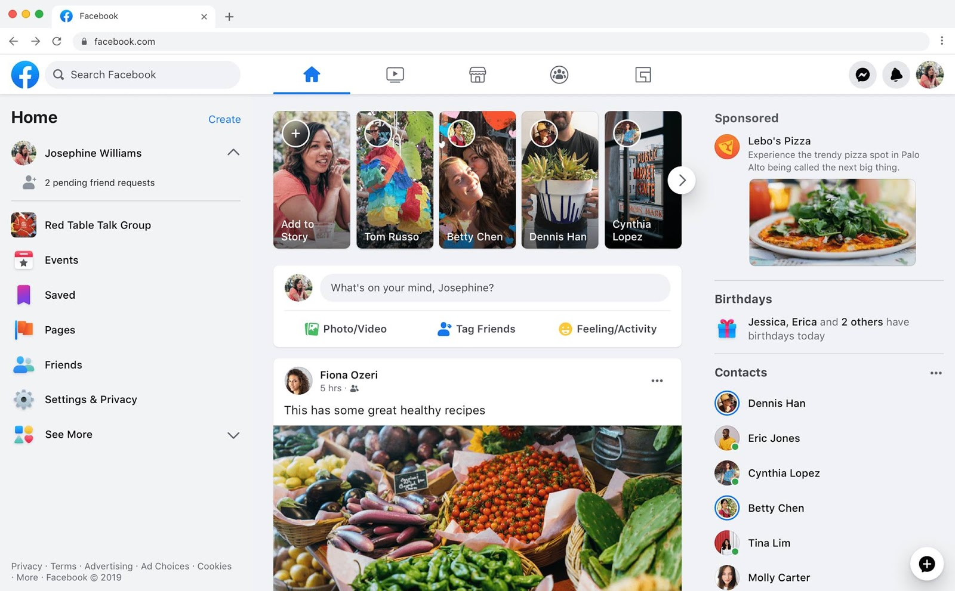
Identify root components of website below

Slide 2
Navigation
Main

Slide 3
Nav-left
Nav-center
Nav-right

Slide 4
image
icon
icon
icon
icon
icon
icon
icon
icon
icon

Slide 5
Content-left
Content-center
Content-right

Slide 6
Text
Button
Icon
Icon
Icon
Text
Icon
Text
Icon
Text
Icon
Text
Icon
Text
Icon
Text
Icon
Text
Icon
Icon
Text
Icon
Text

Slide 7
Div1
Div2
Div3
Div3

Slide 8
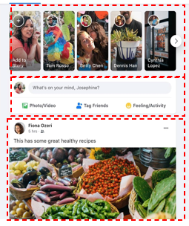
card1
card1
card1
card1
card1
Icon
text
Icon
text
Icon
text
Icon
text
Icon
Text
Icon
Text

Slide 9

icon
text

Slide 10
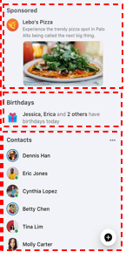
Div1
Div2
Div3

